Slide 1
Trends and Challenges in ABA-Approved Semester Abroad Programs
A Discussion of recent developments affecting the viability of full-term ABA-approved study abroad programs.

Slide 2
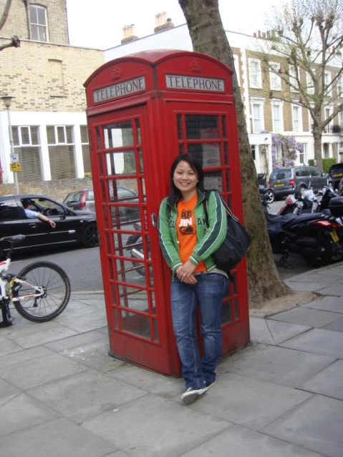
Trends and Challenges in ABA-Approved Semester Abroad Programs
Who are we and who do we represent.
Notes:
Panel members will introduce themselves and their area of responsibility, giving a bit of background on their programs in London.

Slide 3
Trends and Challenges in ABA-Approved Semester Abroad Programs
Pace London Law Program
Stetson Law’s Autumn in London Program
The London Law Consortium (Iowa)
Notre Dame’s J.D. Study in London

Slide 4
Trends and Challenges in ABA-Approved Semester Abroad Programs
What prompted four individuals from such diverse institutions to begin a conversation on our study abroad programs?
Notes:
Lisa to give recent history of changes to ABA criteria and how it effected Pace and Stetson’s program, prompting a cost/benefit analysis at PLS and outreach to those at other schools.

Slide 5
Trends and Challenges in ABA-Approved Semester Abroad Programs
Changes were made to ABA Criteria regarding semester abroad programs in August 2010, and suspended in January 2012 pending further review.
Notes:
Lisa to give recent history of changes to ABA criteria and how it effected Pace and Stetson’s program, prompting a cost/benefit analysis at PLS and outreach to those at other schools.

Slide 6
Trends and Challenges in ABA-Approved Semester Abroad Programs
What are the reasons for a decline in interest in full-term study abroad programs amongst law students and what barriers do students face in seeking a study abroad opportunity?
Notes:
Open conversation with all panelists.

Slide 7
Trends and Challenges in ABA-Approved Semester Abroad Programs
Expenses
Missed opportunities on home campus
Challenges with logistics, such as housing
Conflicting in-house policies governing the threshold for permitting students to study abroad
Questioning the intrinsic value of a study abroad experience
Notes:
Recent economic downturn, poor value of US dollar to the British Pound. Increased student anxiety with being away from home campus during job or internship search, or for OCI, in the hyper competitive and shrinking legal job market. Open conversation.

Slide 8
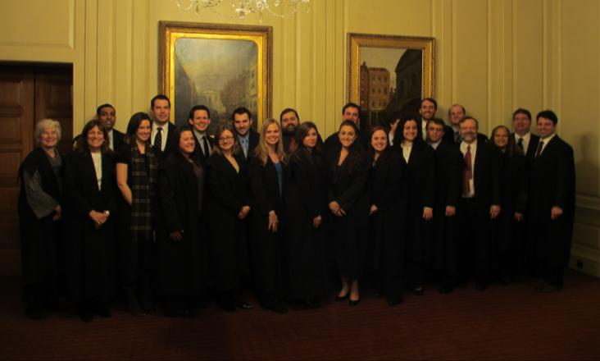
Trends and Challenges in ABA-Approved Semester Abroad Programs
What are we doing to address decreasing enrollments?
Notes:
Open conversation.

Slide 9
Trends and Challenges in ABA-Approved Semester Abroad Programs
Providing additional resources to students such as Notre Dame’s decision to purchase a building to use as a dorm
Increased interest in exploring and developing or expanding partnerships or consortiums to share the costs/risks and to increase the pool of prospective students
Restructuring programs to address concerns of students, faculty and administration
Notes:
Open conversation with all panelists.

Slide 10
Trends and Challenges in ABA-Approved Semester Abroad Programs
Lisa M. Lancia, Pace University School of Law, Director of International Strategic Initiatives and the Pace London Law Program, llancia@law.pace.edu.
John Cooper, Stetson University College of Law, Associate Dean of International and Cooperative Programs, cooper@law.stetson.edu.
Geoffrey J. Bennett, University of Notre Dame, Director, London Law Program, geoffrey.j.bennett.24@nd.edu.
Marcella David, University of Iowa, Professor of Law & International Studies, Associate Dean for International & Comparative Law, marcella-david@uiowa.edu
Notes:
Contact us

Slide 11
Questions and Answers

