Slide 1
Using the Standards of Good Practice to Develop and Manage High Quality Programs
Natalie A. Mello
Executive Director,
Member Services and Training
International Legal Education Abroad Conference
April 2, 2012

Slide 2
The Forum on Education Abroad
Not-for-profit institutional membership association, founded 2001
Recognized by the U.S. Department of Justice and the Federal Trade Commission as the Standards Development Organization (SDO) for education abroad
Members are committed to the Forum’s Standards of Good Practice for Education Abroad
25% of members are located outside of the US
Notes:
BW

Slide 3
Goals of the Forum
Establish Standards of Good Practice
Conduct research to assess outcomes of education abroad and collect useful data
Promote excellence in curriculum design
Advocate for education abroad at all levels
Notes:
BW

Slide 4
Establish Standards
Standards of Good Practice for Education Abroad, 4th edition, 2011
Standards of Good Practice for Short-Term Education Abroad Programs, 2009
Code of Ethics for Education Abroad, 2nd edition, 2011
Education Abroad Glossary, 2nd edition, 2011
Notes:
BW

Slide 5
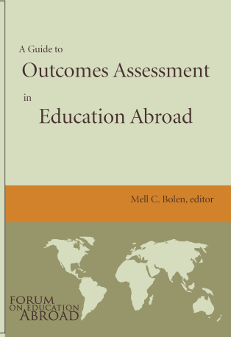
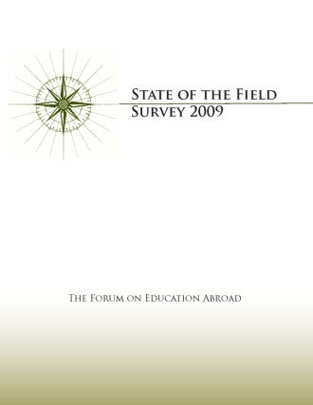
Conduct research & collect data
A Guide to Outcomes Assessment in Education Abroad, 2007
State of the Field Surveys, 2009, 2011
Program Management Survey; Snapshot Survey
Preliminary Report: The Forum Education Abroad Incident Database Pilot Project, 2010
Notes:
NAM

Slide 6
Promote excellence
Quality Improvement Program (QUIP)
Guided Standards Assessments
Annual Forum Conference
Workshops and webinars
Standards Institutes
Ethics and Integrity in Education Abroad, 2011
Outcomes Assessment in Education Abroad, 2012
Beyond the Basics of Health, Safety & Risk Management, 2010, 2011 and 2012
Online Toolbox of Best Practices
Notes:
NAM

Slide 7
Advocate for education abroad
Using Post-9/11 GI Bill Benefits for Study Abroad
The Impact of the New U.S. Federal Financial Aid Regulations on Study Abroad
Licensing to Operate Programs in Cuba
Spanish Student Visa Requirements
Notes:
NAM

Slide 8
Membership
Over 600 institutional members that collectively represent over 90% of U.S. students that study abroad
Members are primarily U.S. colleges and universities, program provider organizations, overseas host institutions and programs, and affiliates that provide services to the field
Members enjoy a wide range of benefits and services that help them to meet the Forum’s Standards of Good Practice for Education Abroad
Notes:
NAM

Slide 9
Where are we now?
Open Doors 2011
Report on International Educational Exchange
American students studying abroad

Slide 10
The Open Doors U.S. Study Abroad Survey
Who is counted? U.S. citizens and permanent residents who received academic credit at their home institution for study abroad
Respondents: Accredited U.S. higher education institutions awarding credit for study abroad
Since 1985 (annually since 1993/94)
Timeframe: study abroad during the 2009/10 academic year, including summer 2010, with credit awarded upon return to campus the following year
Institute of International Education. (2011). Open Doors Report on International Educational Exchange. Retrieved from http://www.iie.org/opendoors
Notes:
Open Doors 2008 Press Briefing
November 17, 2008
10

Slide 11
U.S. Study Abroad, 2009/10
270,604 U.S. students received academic credit for study abroad in 2009/10, up over the prior year.
Institute of International Education. (2011). Open Doors Report on International Educational Exchange. Retrieved from http://www.iie.org/opendoors

Slide 12
Duration of Study Abroad, 1993/94- 2009/10
Short-term (summer, January term or 8 weeks or less during the school year)
Mid-length (one quarter, two quarters or one semester)
Long-term (academic or calendar year)
Institute of International Education. (2011). Open Doors Report on International Educational Exchange. Retrieved from http://www.iie.org/opendoors

Slide 13
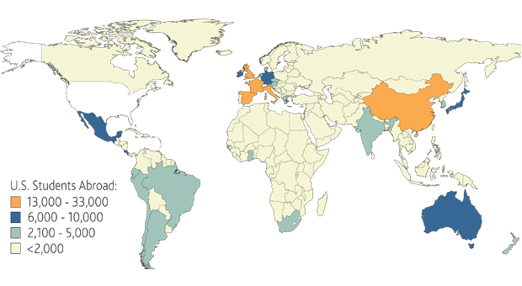
Study Abroad Destinations, 2009/10
Institute of International Education. (2011). Open Doors Report on International Educational Exchange. Retrieved from http://www.iie.org/opendoors

Slide 14
Why are Standards needed?
Notes:
Brainstorming activity here – do as “think-pair-share” and then debrief with entire group.
Should include the following points:
Lack of regulation of the field
Variety of types of Programs
Exchange
Direct Enrollment
Hybrid (independent courses plus direct enrollment)
Courses offered by overseas universities for foreign students
Island programs
Field research programs
Variety of Program “Players”
U.S. Colleges and Universities
Academic departments and faculty members
U.S. providers: not-for-profit and for profit
Overseas providers and stand-alone programs
Overseas universities
Host cultures and societies
Host services
Affiliates that provide services
Limited resources
Increasing number of students participating
Program Variables
Duration: one week to one year
Target Language: Beginning to Advanced
Objectives:
Advancement in disciplines
Global competence
Global citizenship
Intercultural competence
Interpersonal and intrapersonal growth
Language proficiency
Risk and liability concerns
Universities promising global learning outcomes
Accreditation commissions requiring assessment of promised outcomes
Increasing cost of higher education
Raises the question of value on investment
Scrutiny of the industry

Slide 15
Existing Quality Control Mechanisms
Regional and disciplinary accreditation
In-country accreditation and reviews
Institutional guidelines and practices
Internal or outside reviewers
Student evaluations
Faculty and departmental reviews
Advisory boards
The Forum Standards serve as a bridge between all these entities.

Slide 16
Forum Standards of Good Practice
A tool for program assessment & improvement.
Forum is recognized as the Standards Development Organization (SDO) for education abroad by the U.S. Department of Justice and Federal Trade Commission
Obligates the Forum to develop and disseminate Standards through a process that is objective, transparent, open, balanced, and proceeds by consensus
Hundreds of colleagues from within and outside of education abroad have been and are involved in developing the Standards
Notes:
Pilot test last year included U.S.
and overseas universities, U.S.
providers, individual programs
1) Self study
2) Review visits

Slide 17
How were the Standards Developed?
Openness: meetings, presentations, web site, announcements, newsletters, publications
Transparency: full explanation of processes to membership and to the public
Balance: welcome all points of view and diverse perspectives, respect differences and various approaches
Consensus: process of moving forward based on consensus
Due Process: possibility for appeals

Slide 18
Forum Standards of Good Practice
The Standards of Good Practice represent the product of over six years of collaboration and reflect the input and shared vision of education abroad professionals from around the world
They have been pilot tested and are revised and updated based on the experience of their being applied
They are endorsed by the growing Forum membership
Notes:
Standards development followed SDO guidelines:
Transparency
Consensus
Due process

Slide 19
Standards of Good Practice for Education Abroad
Mission
Student Learning & Development
Academic Framework
Student Preparation for the Learning Environment Abroad & Returning Student Support
Student Selection & Code of Conduct
Policies and Procedures
Organizational & Program Resources
Health, Safety, Security & Risk Management
Ethics & Integrity

Slide 20
Standards Content
Statements of good practice
articulate the core Forum Standards that serve as guidelines;
Queries
relate to each Standard; these are designed to foster analysis and assessment of how well an organization meets the Standards; and
Toolbox
documents to which Forum members may refer as models of good practice and discuss or adapt them to their institutions or programs, as appropriate.
Notes:
Statements of good practice—articulate the core Forum Standards;
Queries—related to each category, these are designed to foster reflection and further discussion of aspects related to each of the Standards categories; and
Resources—documents to which Forum members may refer to as models of good practice and discuss or adapt them to their institutions or programs, as appropriate.

Slide 21
One example:
Standard 8: Health, Safety, Security & Risk Management
Statement
Queries
Toolbox resources

Slide 22
Health, Safety, Security & Risk Management:
The organization assures continuous attention to the health, safety, and security of its students, faculty, and staff, from program development stages through program implementation, by way of established policies, procedures, student orientation, and faculty and staff training.
Health, safety, security and risk management in program development
Health issues for program students, faculty and staff
Safety of students, faculty and staff at all locations
On going risk-management review
Adherence to applicable laws and regulations
Risk assessments are conducted throughout

Slide 23
The organization considers health, safety, security and risk management in program development.
What are the organization’s procedures for considering the safety (blah, blah, blah)?
What role does the evaluation of risk, (blah, blah, blah)?
How does program development include evaluations of the experience and competence of staff in relation to (blah, blah, blah)?
How does the organization consider legal and ethical issues (blah, blah, blah)?
How does the program determine participant/staff ratio (blah, blah, blah)? What protocols are in place (blah, blah, blah)?
How does program development include a vetting of all home-stay families?
In the development of (blah, blah, blah) how does the program consider the safety of all transportation, orientation activities, itineraries, and venues?

Slide 24
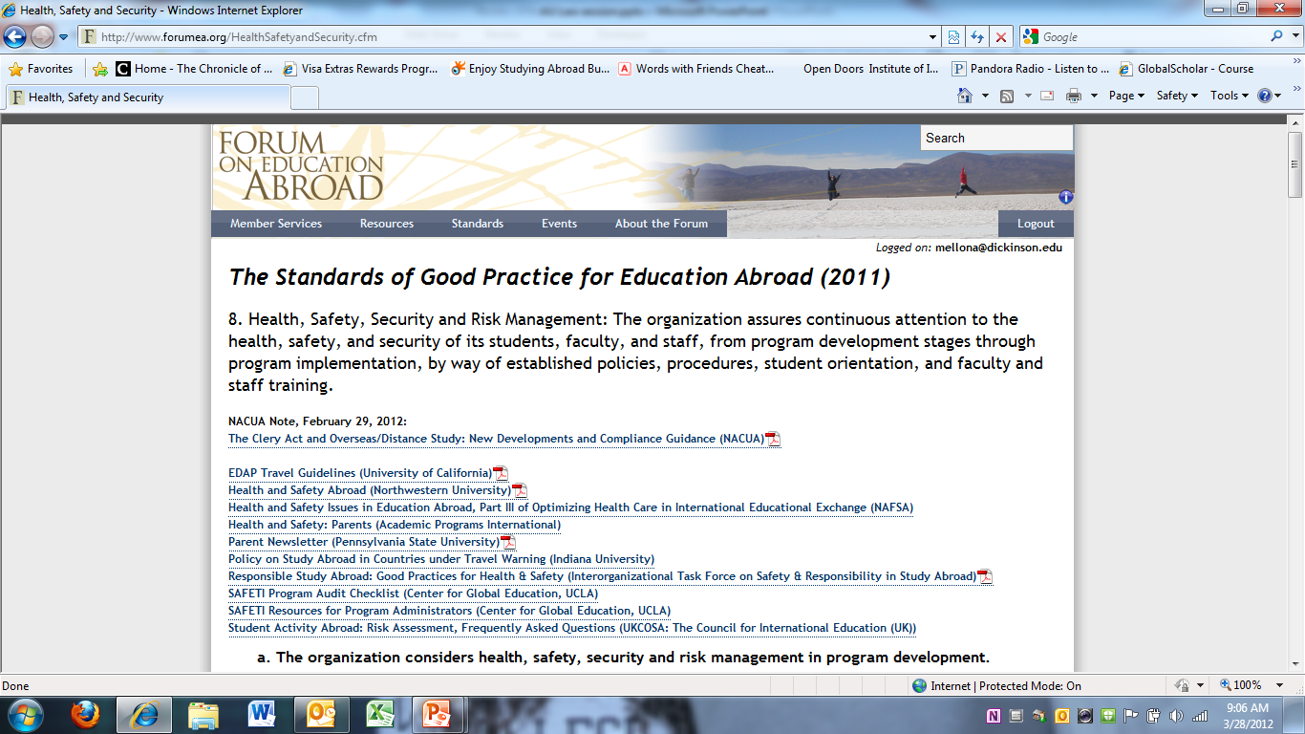

Slide 25
Standards of Good Practice Institute Beyond the Basics of Health, Safety and Risk Management
Deepen your knowledge & understanding
of Standard 8
Explore approaches from within as well as beyond the field of education abroad
Enhance your knowledge and skills to meet Standard 8 by analyzing its requirements & sharing best practices
Enhance the overall safety & security for the benefit of all
The George Washington University, Washington, DC June 12, 2012

Slide 26
The Forum on Education Abroad
www.forumea.org

